Slide 1
The equation of a straight line
Graphical representations of linear equations

Slide 2
how to use Oak lessons

Slide 3
I can appreciate that writing linear equations in the form y = mx + c helps to reveal the structure.

Slide 4
A numerical coefficient is a constant multiplier of the variables in a term.
A constant is a term that does not change; it contains no variables.
E.g. in the equation y = 3x − 5 , 3 is the coefficient of x and the constant term is −5

Slide 5
An equation of a line is any equation whose graph forms a straight line.

Slide 6

The equation of a straight line
Different forms of linear relationships
Gradient and y-intercept from y = mx + c

Slide 7
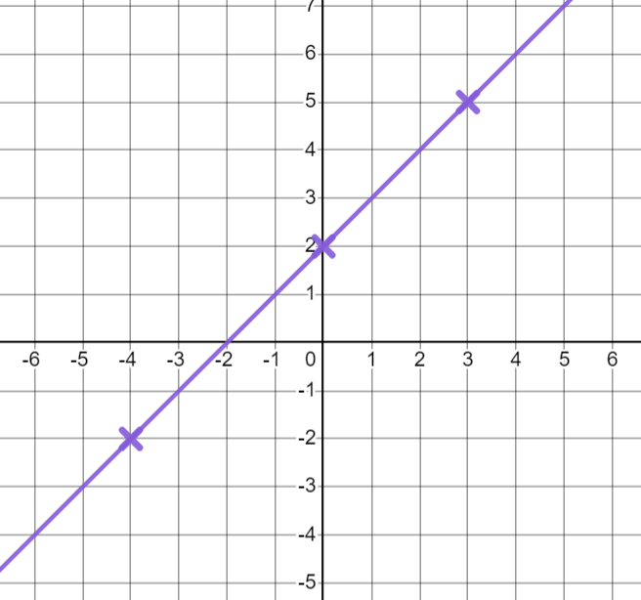
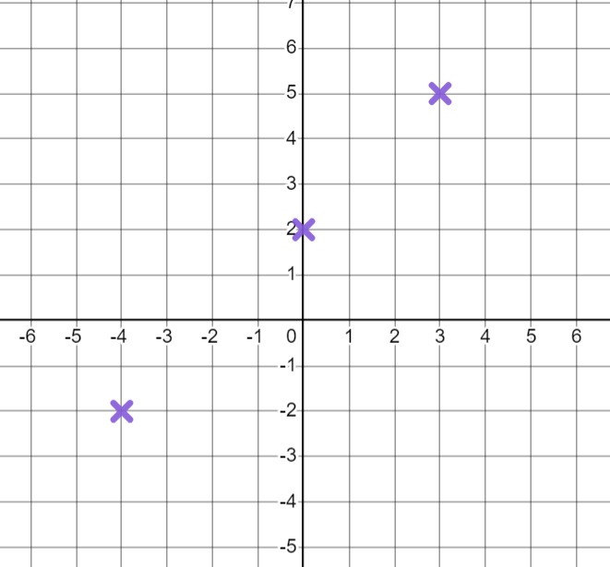
Different forms of linear relationships
We can plot linear relationships to investigate their features.
To plot the linear relationship y = x + 2 we need at least two coordinates that follow the rule. What coordinates can you think of?
E.g (0, 2) (3, 5) (10, 12) (−2, 0) (−4, −2)
It is helpful to plot 3 points to check they all form a straight line.
Joining them up with a ruler will show the graph of the relationship y = x + 2
We call y = x + 2 the equation of this line.

Slide 8
Different forms of linear relationships
How could we describe this line using keywords and features.
E.g. As x increases, y increases.
It has a positive gradient.
It has a gradient of 1
It has a y-intercept of (0, 2)
y is always 2 more than x

Slide 9
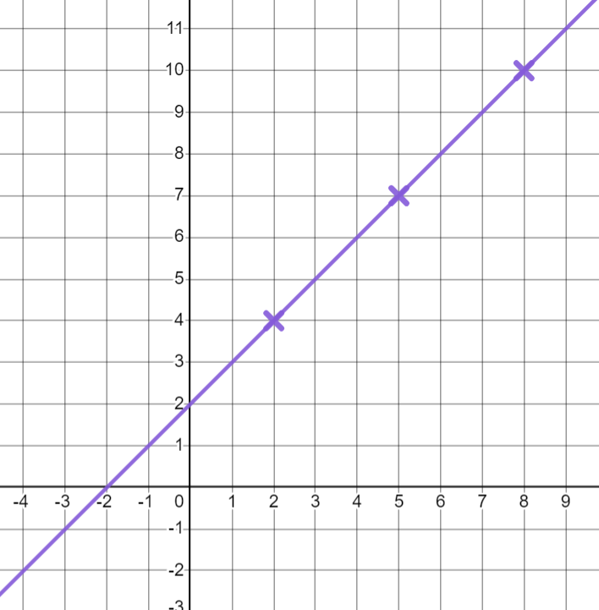
Different forms of linear relationships
We can plot any linear equation on a graph.
Can you think of any coordinates that fit the rule y − x = 2?
E.g (8,10) (2,4) (0,2) (5,7)
Plotting these coordinates and drawing a line, will give us the line with equation y − x = 2
What do you notice about this line?
It has the same features as y = x + 2

Slide 10
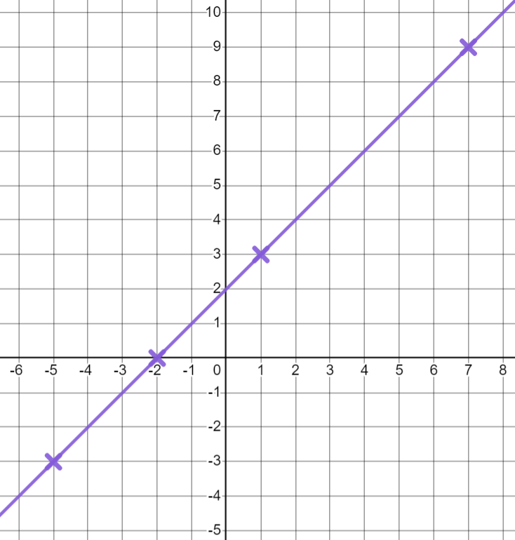
Different forms of linear relationships
We are now going to plot x = y − 2
Will it look the same as the others?
What are the x coordinates for the y coordinates chosen below?
( , 3) ( , 9) ( , 0) ( , −3)
(1, 3) (7, 9) (−2, 0) (−5, −3)
This is the line x = y − 2
It is the same line as y = x + 2 and y − x = 2

Slide 11
Different forms of linear relationships
The equation of a straight line can be written in different forms.
The graphs of y = x + 2, y − x = 2 and x = y − 2 are all the same because all these equations represent the same linear relationship.
This can be shown by a bar model.
y =
x + 2
y
y
− x = 2
x
2
x =
y − 2
Some forms of equations of lines are more common than others.
Different forms can be helpful at different times.

Slide 12
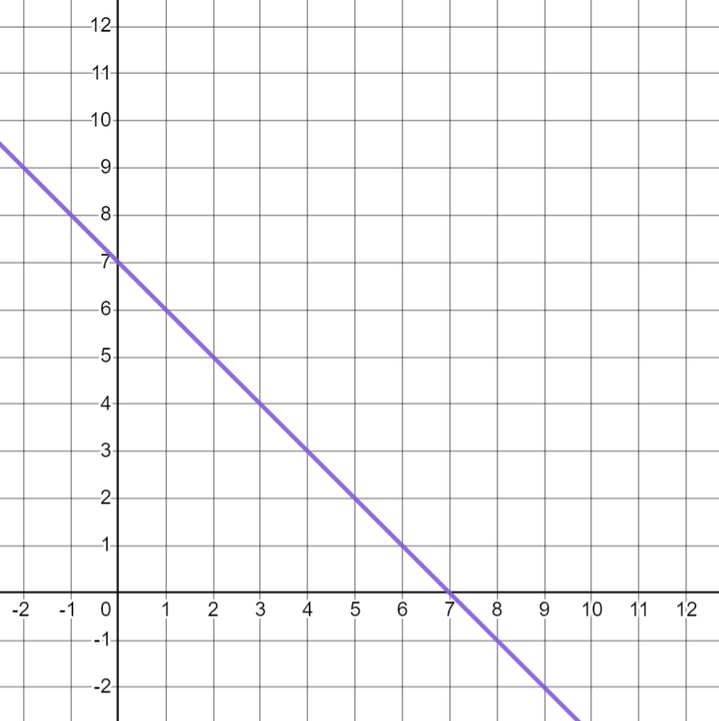
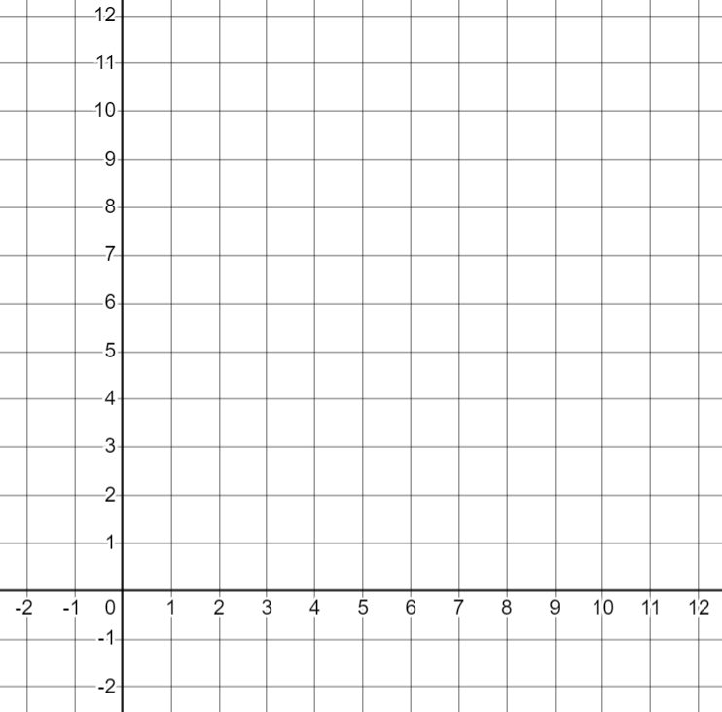
Different forms of linear relationships
Let’s have a go at plotting the equation x + y = 7
Can you think of any coordinates where x + y = 7?
E.g (0, 7) (7, 0) (4, 3) (6, 1) (2, 5)
What will they look like when plotted?
What is the gradient and y-intercept?
gradient = −1
y-intercept = (0, 7)

Slide 13
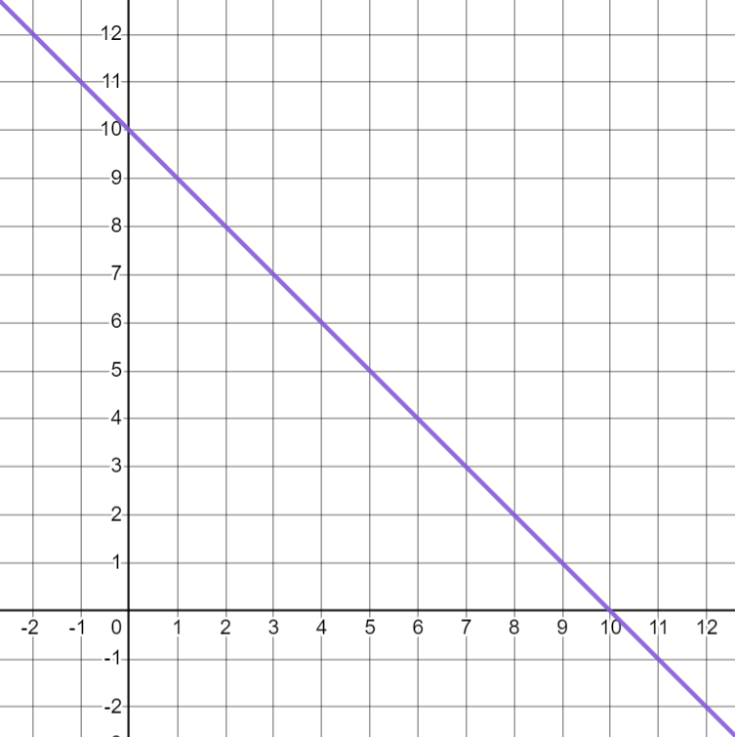
Different forms of linear relationships
What do you think x + y = 10 will look like?
What is the gradient and y-intercept?
gradient = −1
y-intercept = (0, 10)

Slide 14
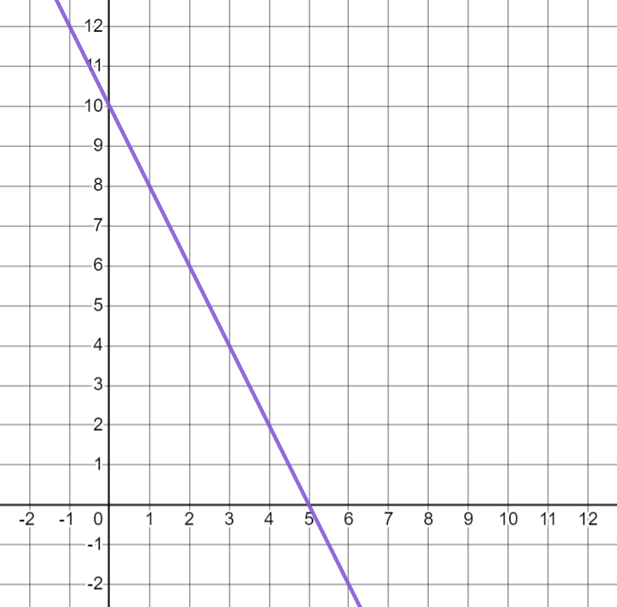
Different forms of linear relationships
What do you think 2x + y = 10 will look like?
Can you think of any values for x and y that satisfy this relationship?
E.g (0, 10) (1, 8) (2, 6) (3, 4) (5, 0)
gradient = −2
y-intercept = (0, 10)

Slide 15

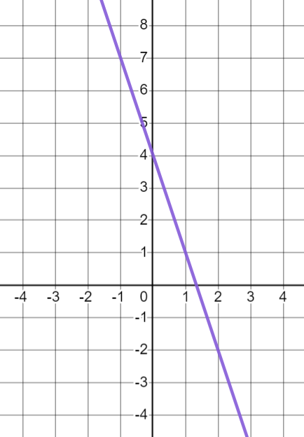
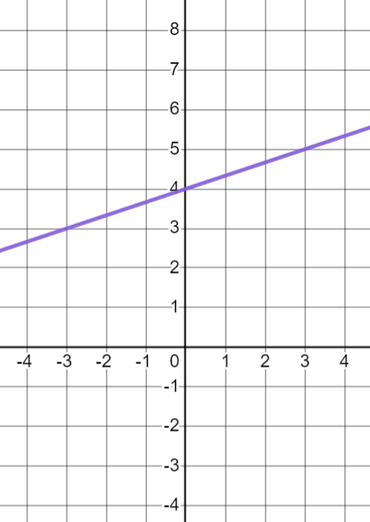

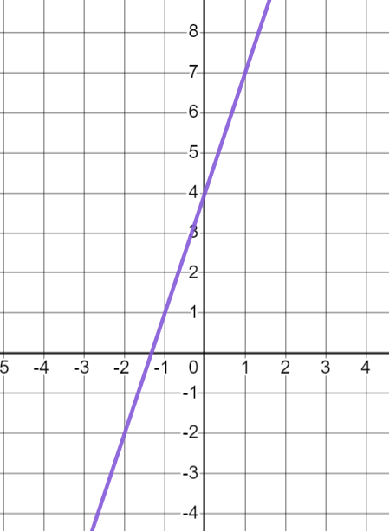
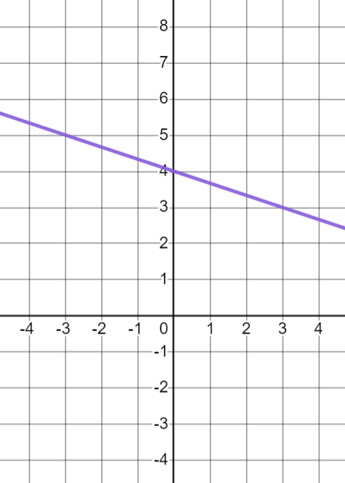

Different forms of linear relationships
Match the graph to the key features.
a
c
gradient = 3, y-intercept 4
gradient = −3, y-intercept 4
gradient = , y-intercept 4
b
d
gradient = , y-intercept 4

Slide 16
Different forms of linear relationships
Match the graph to the key features.
a
c
gradient = ,
y-intercept 4
gradient = −3,
y-intercept 4
b
d
gradient = 3,
y-intercept 4
gradient = ,
y-intercept 4

Slide 17
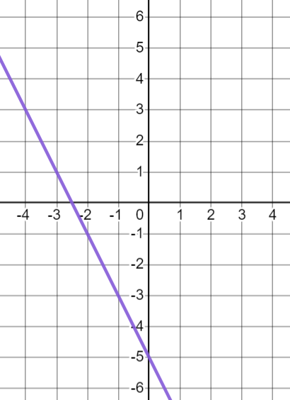
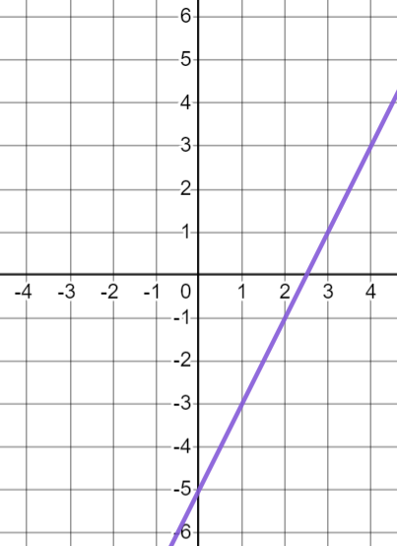
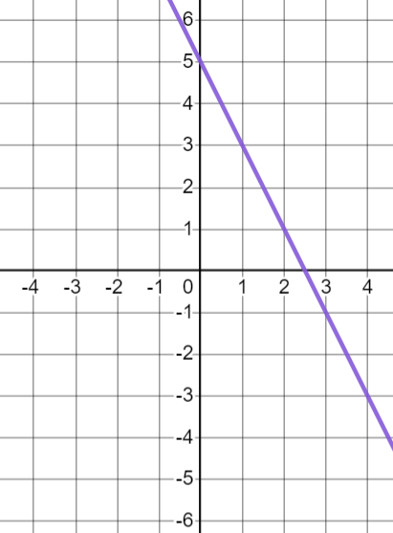
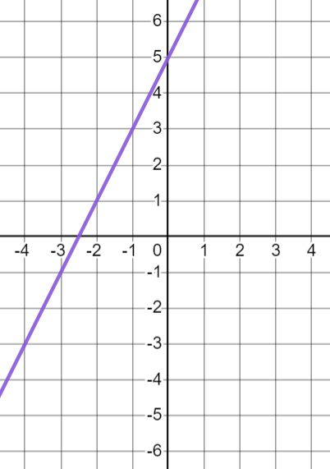
Different forms of linear relationships
Match the graph to the key features.
a
c
gradient = 2, y-intercept 5
gradient = −2, y-intercept 5
gradient = 2, y-intercept −5
b
d
gradient = −2, y-intercept −5

Slide 18
Different forms of linear relationships
Match the graph to the key features.
a
gradient = −2,
y-intercept −5
c
gradient = 2,
y-intercept −5
gradient = −2,
y-intercept 5
gradient = 2,
y-intercept 5
b
d

Slide 19
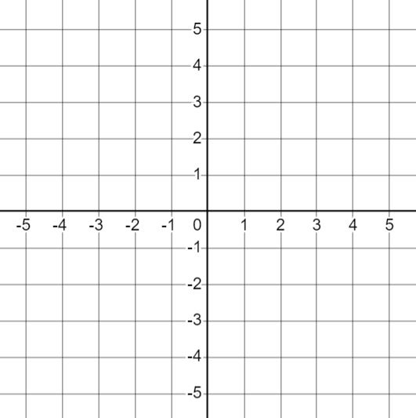
Different forms of linear relationships
Plot each equation and identify the gradient and y-intercept.
x + y = 5 | b) y = 2x − 5 | c) y = 5 − 2x | d) 2x + 2y = 10
gradient =
y-intercept =
gradient =
y-intercept =
gradient =
y-intercept =
gradient =
y-intercept =
2) Match up any equations that represent the same relationship.

Slide 20

Different forms of linear relationships
3) Plot each equation and identify the gradient and y-intercept.
x + y = 4 | b) y = 4 − x | c) y = x + 2 | d) 2y + x = 4
gradient =
y-intercept =
gradient =
y-intercept =
gradient =
y-intercept =
gradient =
y-intercept =
4) Match up any equations that represent the same relationship.

Slide 21
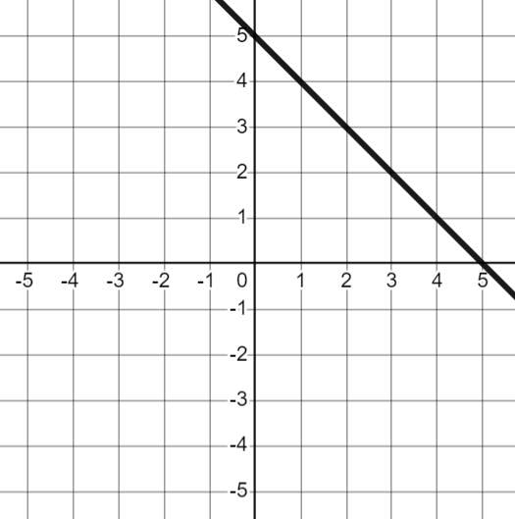
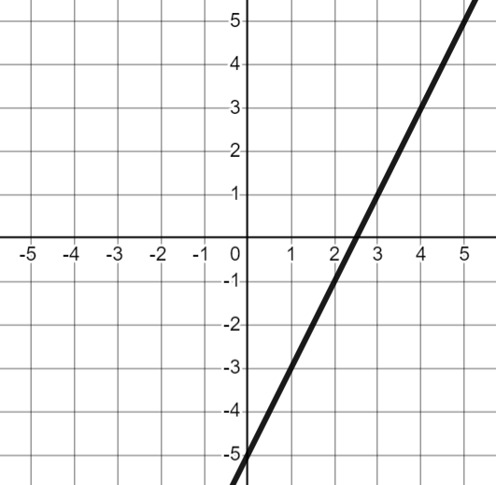
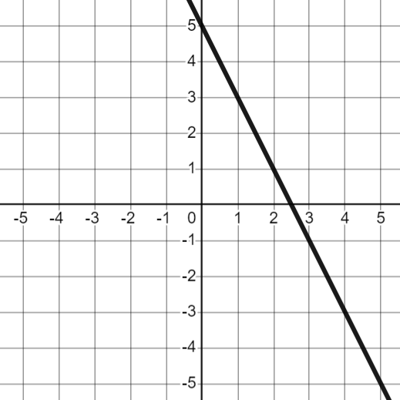

Different forms of linear relationships
Plot each equation and identify the gradient and y-intercept.
x + y = 5 | b) y = 2x − 5 | c) y = 5 − 2x | d) 2x + 2y = 10
gradient = −1
y-intercept = (0, 5)
gradient = 2
y-intercept = (0, −5)
gradient = −2
y-intercept = (0, 5)
gradient = −1
y-intercept = (0, 5)
2) Match up any equations that represent the same relationship.
a) and d)

Slide 22
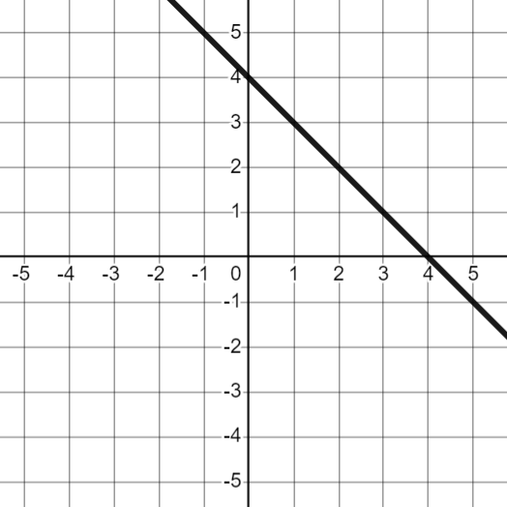
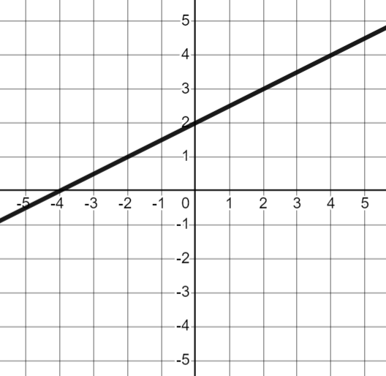
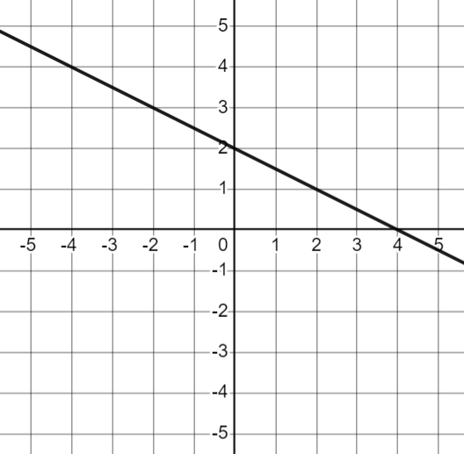

Different forms of linear relationships
3) Plot each equation and identify the gradient and y-intercept.
x + y = 4 | b) y = 4 − x | c) y = x + 2 | d) 2y + x = 4
gradient = −1
y-intercept = (0, 4)
gradient = −1
y-intercept = (0, 4)
gradient =
y-intercept = (0, 2)
gradient =
y-intercept = (0, 2)
4) Match up any equations that represent the same relationship.
a) and b)

Slide 23
The equation of a straight line
Different forms of linear relationships
Gradient and y-intercept from y = mx + c

Slide 24

Gradient and y-intercept from y = mx + c
Some forms of equations of lines make it easier to see the key features of the graph than others.
One of the more common forms to write an equation of a line in is:
y = mx + c
Examples
y = 2x + 4
y = 3x + 1
y = x + 8
y = x
y = 2x − 3
y = −5x
y = 6 − 4x
y = 7 + x
Non- examples
x = 3
x + y = 6
2y = x + 8
y + x + 1 = 0

Slide 25
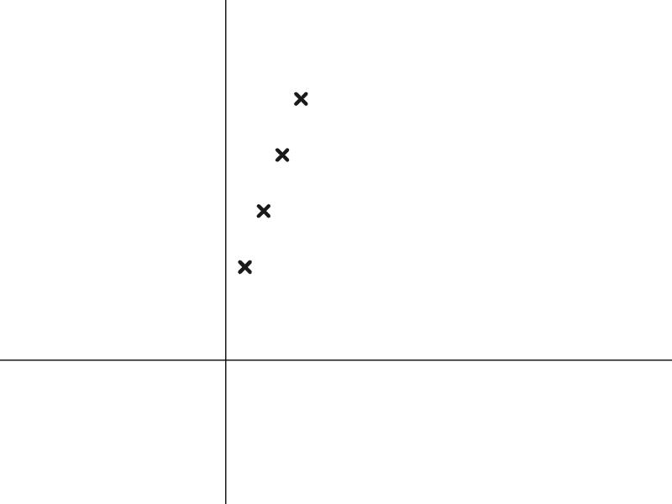


Gradient and y-intercept from y = mx + c
The general equation y = mx + c is similar to how you might write the n^{th} term of a linear sequence.
Here is the sequence 3n + 2 represented graphically.
What does the 3 in the n^{th} term represent?
Each term is adding an extra 3 each time (3 pink blocks).
What does the 2 in the n^{th} term represent?
2 is the constant term. (There are 2 blue blocks in each term.)

Slide 26
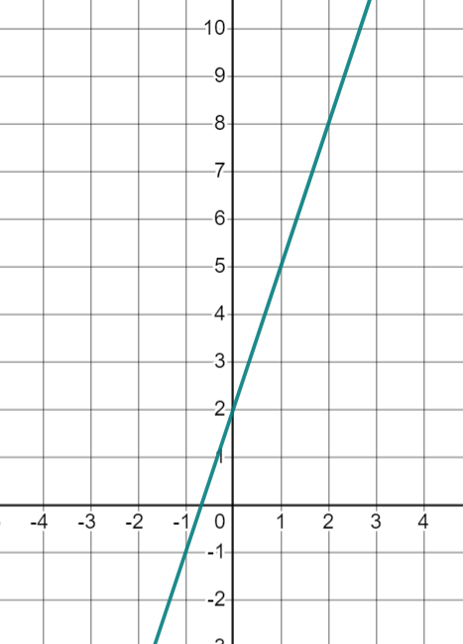
Gradient and y-intercept from y = mx + c
Here is the graph of the equation y = 3x + 2 represented graphically.
What does the 3 in the equation of the line represent?
The gradient of the line.
What does the 2 in the equation of the line represent?
The y-intercept is (0, 2)

Slide 27
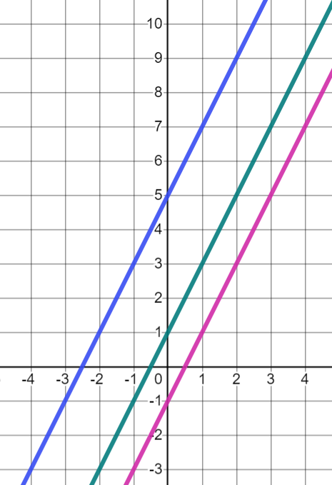
Gradient and y-intercept from y = mx + c
Here are the graphs of y = 2x + 1, y = 2x + 5 and y = 2x − 1
A
B
Which graph belongs to which equation? How do you know?
The y-intercept is (0, 5)
C
A- (Blue) is y = 2x + 5
B- (Green) is y = 2x + 1
The y-intercept is (0, 1)
C- (Pink) is y = 2x − 1
The y-intercept is (0, −1)
What is the same in all 3 graphs?
The gradient is 2

Slide 28
Gradient and y-intercept from y = mx + c
When the equation of a line is written in the form: y = mx + c the gradient and y-intercept are easy to identify.
y = mx + c
The coefficient of x (m) is the gradient of the line.
The constant (c) is the y-intercept.
(x is always 0 at the y-intercept.)
It is not known for sure why the letters m and c are used.
It has been suggested that m comes from the french word ‘monter’ which means ‘to climb or ascend’.
And c from ‘commencer’ which means ‘to start’.

Slide 29




Gradient and y-intercept from y = mx + c
Three pupils are trying to work out the gradient and y-intercept by looking at equations of lines.
What mistake has each person made?
The y-intercept is (0, 5) and the gradient is 4
y = 5x + 4
Aisha
The gradient is 2 and the y-intercept is (0, 1)
y = 2x − 1
Jacob
The gradient is 0 and the y-intercept is (0, −2)
y = x − 2
Lucas

Slide 30
Gradient and y-intercept from y = mx + c
What mistakes have been made?
The y-intercept is (0, 5) and the gradient is 4
y = 5x + 4
Aisha
So the y-intercept is (0, 4) and the gradient is 5
Aisha has looked at the wrong values. The coefficient of x is the gradient and the constant is the y-intercept.

Slide 31
Gradient and y-intercept from y = mx + c
What mistakes have been made?
The gradient is 2 and the y-intercept is (0, 1)
y = 2x − 1
Jacob
Jacob has got the gradient correct but his y-intercept will be negative because the constant is −1
So the y-intercept is (0, −1)

Slide 32
Gradient and y-intercept from y = mx + c
What mistakes have been made?
The gradient is 0 and the y-intercept is (0, −2)
y = x − 2
y = 1x − 2
Lucas
Lucas has got the y-intercept correct. He has got the gradient wrong, the coefficient of x is 1 not 0.
So the gradient is 1 and the y-intercept is (0, −2)

Slide 33
Gradient and y-intercept from y = mx + c
Sometimes the x term is written after the constant term.
For example, in the equation y = 5 − 2x
This is still in the form: y = mx + c
What do you think the gradient and y-intercept for this equation are?
The coefficient of x is −2 so the gradient is −2
The constant is 5 so the y-intercept is (0, 5)

Slide 34

Gradient and y-intercept from y = mx + c
So in the equation 2y = 10 − 4x the gradient is −4 and the y-intercept is (0, 10)
Laura
Can you explain why Laura is still incorrect?
Her equation is not in the form y = mx + c
y has a coefficient other than 1

Slide 35
Gradient and y-intercept from y = mx + c
What can I do to work out the gradient and y-intercept for the equation y = 2(3x− 4) ?
Laura
We can use our expanding bracket skills to write in the form y = mx + c
2(3x− 4) ≡ 6x − 8
y = 6x − 8
So the gradient is 6 and the y-intercept is (0, −8)

Slide 36

Gradient and y-intercept from y = mx + c
The coefficient of x in any linear equation represents the gradient.
It is the constant that represents the gradient.
This is only true when the equation is in the form y = mx + c

Slide 37
Gradient and y-intercept from y = mx + c
When in the form y = mx + c the constant represents the y-intercept.
The y-intercept represents the value of y when x equals 0
The constant is the last term in the expression.

Slide 38
Gradient and y-intercept from y = mx + c
1) Fill in the table with the gradient and y-intercept for each equation.
2) Fill in the missing pieces of information for each question.
Write the y-intercept as a coordinate
equation | gradient | y-intercept
a) y = x + 4 | 9 | (0, )
b) y = − 6x | . | ( , )
c) y = 3(4x + 2). | . | ( , )
d) y = 10 . | −1 | (0, )
e) 5(1 − 2x) = y | . | ( , )
f) 8 − x = y | −5 | (0, )
g) y = + x | t | (0, u)
equation | gradient | y-intercept
a) y = 8x + 4
b) y = 3x − 7
c) y = −5x + 1
d) y = 10 − 3x
e) y = x
f) y = −x
g) y = 5
h) y = p + (q + 3)x

Slide 39
Gradient and y-intercept from y = mx + c
1) Fill in the table with the gradient and y-intercept for each equation.
2) Fill in the missing pieces of information for each question.
Write the y-intercept as a coordinate.
equation | gradient | y-intercept
a) y = 9x + 4 | 9 | (0, 4)
b) y = − 6x | −6 | (0, )
c) y = 3(4x + 2) | 12 | (0, 6)
d) y = 10 − x | −1 | (0, 10)
e) 5(1 − 2x) = y | −10 | (0, 5)
f) 8 − 5x = y | −5 | (0, 8)
g) y = u + tx | t | (0, u)
equation | gradient | y-intercept
a) y = 8x + 4 | 8 | (0, 4)
b) y = 3x − 7 | 3 | (0, −7)
c) y = −5x + 1 | −5 | (0, 1)
d) y = 10 − 3x | −3 | (0, 10)
e) y = x | 1 | (0, 0)
f) y = −x | −1 | (0, 0)
g) y = 5 | 0 | (0, 5)
h) y = p + (q + 3)x | q + 3 | (0, p)

Slide 40
The equation of a straight line
Equations of straight lines can be written in different forms.
Writing in the form y = mx + c allows us to see the gradient and the y-intercept easily.
In the general equation y = mx + c, the coefficient of x (m) is the gradient and the constant (c) is the y-intercept.

Slide 41

© Oak National Academy 2023.
Produced in partnership with Mathematics in Education and Industry.
Licensed on the Open Government Licence v3.0, except where otherwise stated. See Oak terms and conditions.

